Slide 1


FYP
HR System for Hiring
Muhammad Hassan (1669-2021)
Ramiz Shahnawaz (1678-2021)
Shayan Yar Khan (1889-2021)
Department of Computing, FEST
Hamdard University
Supervisor: Mr. Aamir Hussain
Co-Supervisor: Maaz Ahmed

Slide 2
Summary
Problem Statement
Objective
FYP Scope
Our methodology
Our Project Plan (Time lines)
Budget / Costing (if any)
FYP Deliverables
Literature Review
Test Plan & Test Cases

Slide 3
Problem Statement
The hiring process in today's workplace frequently requires a
large amount of manual labor, from collecting resumes to
shortlisting applicants and setting up interviews. This
time-consuming procedure may result in higher expenses,
longer hiring periods, and inefficiencies.
Candidates and HR personnel struggle to go through numerous
resumes and companies often waste time and manpower trying
to find the best fit for open positions. As a result, Candidates
often struggle with the lack of visibility and opportunities, HR
personnel are left with little time to focus on other tasks, and
companies lack the resources to effectively hire top talent.

Slide 4
Objective
To develop an efficient, system that connects candidates with job opportunities, facilitates HR tasks, simplifies the hiring process for organizations and improve candidate management efficiency.

Slide 5
FYP Scope
The following significant elements will be a part of the project.
Improving the overall efficiency of HR processes and procedures.
Simplifying and optimizing hiring processes.
Provide organization to manage job openings, hire HR professionals, and automate shortlisting.
Allow HR professionals and Organizations to conduct assessments and schedule interviews.
Allow candidates to apply for jobs, give assessment, and attend interviews.

Slide 6
FYP Scope
Out of Scope:
Payment agreement between HR professionals and companies.
Candidate evaluation based on non-quantifiable criteria (such as cultural fit).
Enhanced AI-powered hiring techniques beyond defined requirements.
Assumptions and Dependencies:
Availability of qualified interviewers
Reliable video conferencing and recording capabilities
Timely feedback and cooperation from clients and candidates
Project Constraints:
Limited initial budget and resources
Tight development timeline for MVP launch
Potential challenges in scaling the platform quickly

Slide 7
Our Methodology
The Evolutionary Prototyping methodology has been adopted for the development of HR System to ensure a user-centered, flexible, and iterative process. This approach allows the system to evolve over time based on continuous feedback and refinement, ultimately aligning with the users’ needs and project objectives.
Why Evolutionary Prototyping?
User-Centric Approach: Stakeholder feedback is continuously integrated, ensuring the system meets user expectations (candidates, HRs, organizations).
Flexibility: Allows incremental development, enabling modifications at any stage of the project.
Risk Mitigation: Identifies and addresses potential issues early in the development process.
Improved Quality: Regular testing and validation ensure a reliable and effective final product.

Slide 8
Our Methodology
Key Steps in Evolutionary Prototyping
1. Requirement Gathering and Initial Prototype
Conducted interviews and surveys with potential users to identify core functionalities.
Developed a basic prototype focusing on essential features such as login, CV submission, and job posting.
2. Incremental Development
Additional functionalities, such as automated shortlisting and scenario-based testing, are integrated iteratively.
Feedback from mock users is collected and included at each stage.

Slide 9
Our Methodology
3. Testing and Refinement
Regular testing cycles (unit testing, integration testing, and user acceptance testing) are conducted.
Identified issues are resolved, and the system is fine-tuned for optimal performance.
4. Final Prototype and Deployment
A near-complete system is tested thoroughly and prepared for the final demonstration.
The system is deployed for broader use while maintaining flexibility for future updates.

Slide 10
Our Methodology
Advantages of Evolutionary Prototyping for the system
Encourages active collaboration among the team and stakeholders.
Delivers a working model early, allowing stakeholders to visualize progress.
Supports the development of a scalable and robust system aligned with future goals, such as evolving into a startup.

Slide 11
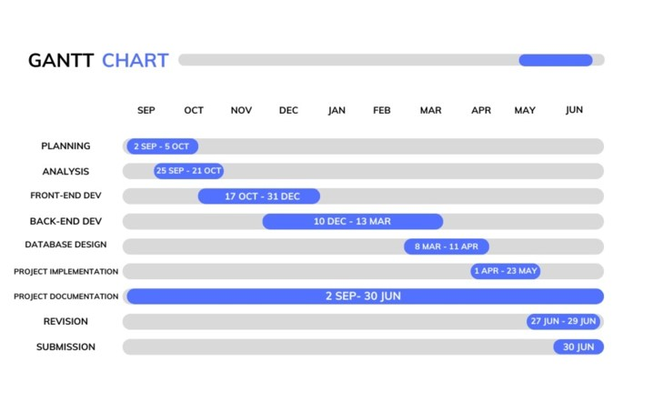
Our Project Plan

Slide 12
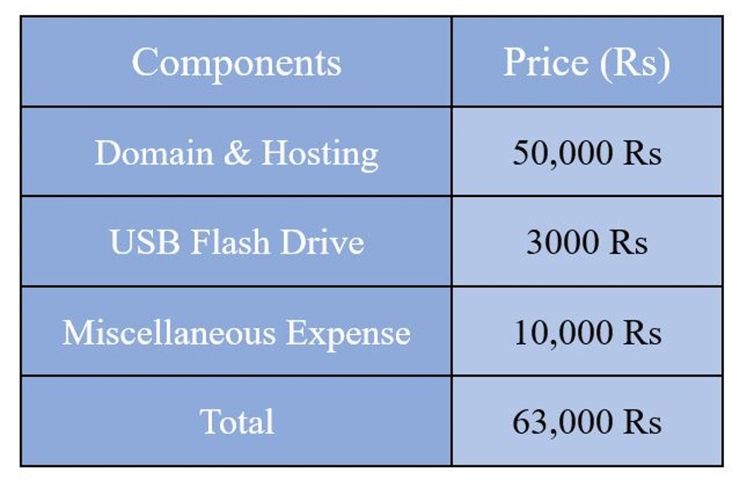
Budget / Costing

Slide 13
FYP Deliverables
First Evaluation
SRS Document Complete Front-End
Complete Back-End
FYP1 Report
Second Evaluation
CV sorting functionality (AI based)
AI based scenario testing functionality
Interview scheduling functionality
FYP Final Report

Slide 14
Literature Review
The hiring industry plays a vital role in organizational success but often suffers from inefficiencies. Manual resume screening can consume up to 23% of hiring time, while a lack of structured assessment tools contributes to biased decisions. Automation shows promise—technologies like CV screening and candidate ranking can reduce hiring timelines by up to 40%. However, a key challenge remains: developing platforms that are both comprehensive and user-friendly.

Slide 15
Test Plan & Test Cases
S.No | Description | Test Engineer | Start Date | End Date
1 | Candidate Login Screen | Muhammad Hassan | 15-Nov-2024 | 15-Nov-2024
2 | Candidate Dashboard | Muhammad Hassan | 2-DEC-2024 | 2-DEC-2024
3 | Job Application Screen | Muhammad Hassan | 5-DEC-2024 | 5-DEC-2024
4 | HR Login Screen | Muhammad Hassan | 15-Nov-2024 | 15-Nov-2024
5 | HR Dashboard (CV Sorting) | Muhammad Hassan | 19-Mar-2025 | 19-Mar-2025
6 | Assessment Creation | Muhammad Hassan | 3-Apr-2025 | 3-Apr-2025
7 | Company Login Screen | Muhammad Hassan | 15-Nov-2024 | 15-Nov-2024
8 | Job Posting Screen | Muhammad Hassan | 29-Nov-2024 | 29-Nov-2024
9 | AI Shortlisting Report | Muhammad Hassan | 27-May-2025 | 27-May-2025

Slide 16


